Slide 1
Echocardiography in Mitral Valve Prolapse and Endocarditis
Note: Ao = aorta, AV = aortic valve
LA = left atrium, LV = left ventricle
MV = mitral valve
There is narration in the text boxes in Normal View.
Notes:
Hover over bottom of images when in PowerPoint “Normal” mode. Video loops will display a “playbar”. Click the “play” symbol and it should play until paused. Loops are a 1 or 2 cardiac cycles. You may click and drag the playbar to view individual frames. Use the EKG signal for timing. Use “Slide Show” mode to see larger images playing continuously.

Slide 2
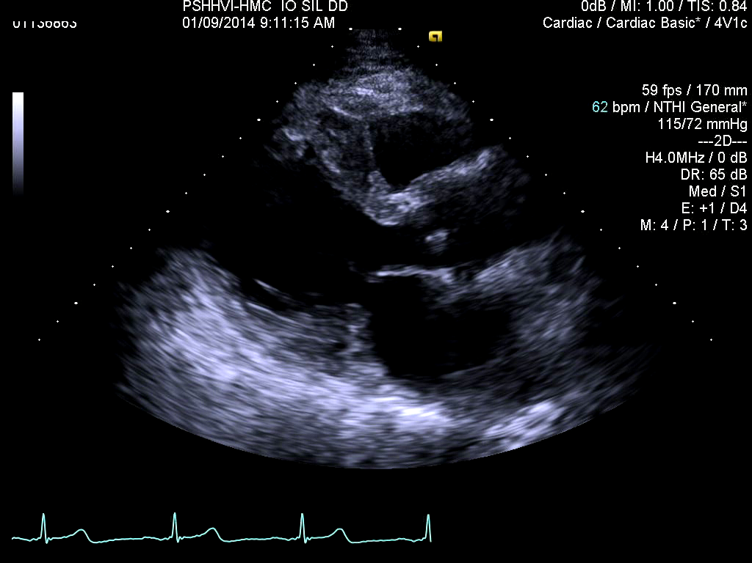
Posterior leaflet mitral valve prolapse in a parasternal long axis view.
LV
Ao
LA
Notes:
The yellow arrow points to the left atrial side of the prolapsing posterior MV leaflet. Normally the posterior leaflet coapts with the anterior leaflet in the LV inlet, meeting like two hands palm to palm, with the arms representing the body of the two leaflets that form a plane. The patient has moderate to severe mitral regurgitation (but doppler not shown).

Slide 3
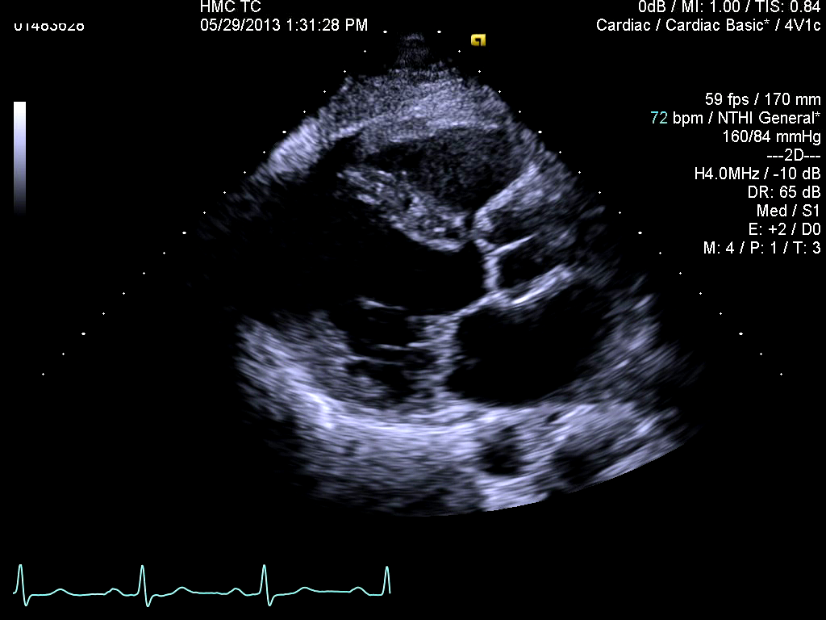
Severe bileaflet mitral valve prolapse in a parasternal long axis view.
Ao
LV
LA
Notes:
Both mitral valve leaflets are thick and dysplastic, both prolapse into the left atrium, and portions of both leaflets “flail”. That is, their tips point toward the left atrium implying broken mitral chordae. The patient has severe mitral regurgitation (again, no doppler), has excellent left ventricular function, and is asymptomatic.

Slide 4
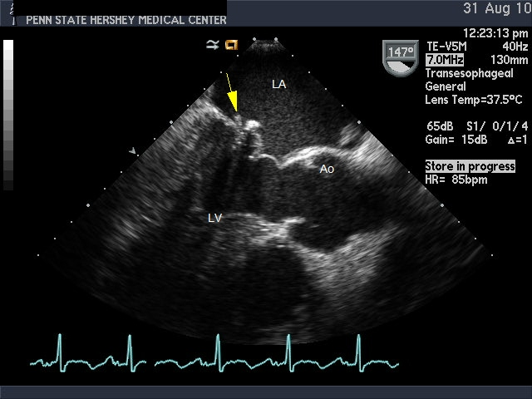
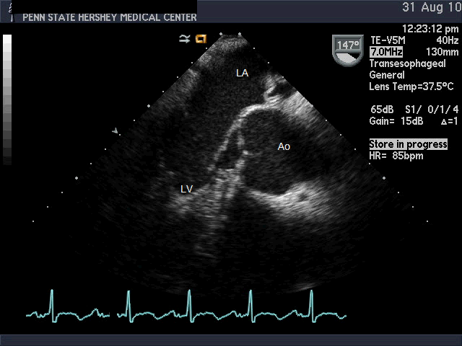
Anterior leaflet mitral valve prolapse in a transesophageal long axis view. Note a small, mobile vegetation on the posterior leaflet.
Notes:
The yellow arrow points to the small vegetation in the still frame on the left taken from the video clip on the right. This kind of small vegetation can be missed on a transthoracic echo.

Slide 5
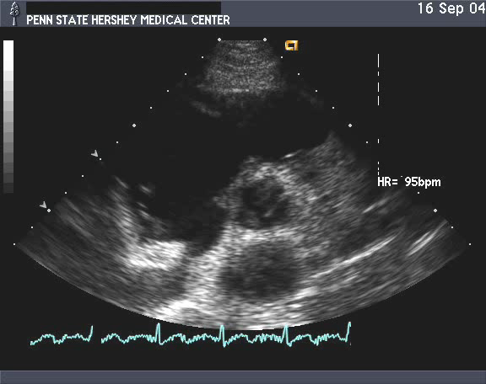
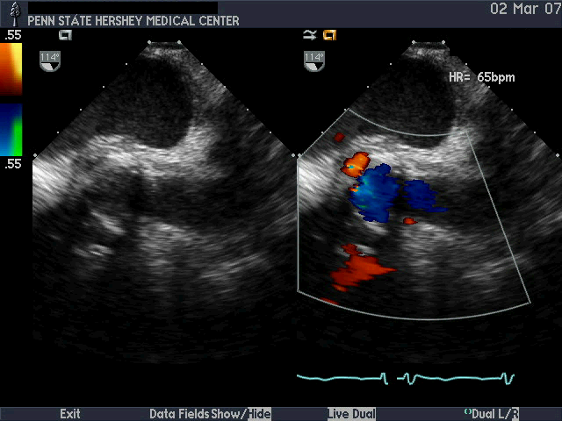
Tricuspid valve vegetation
Aortic root abscess
LA
RV
*
Ao
RA
LV
LA
Notes:
Left panel: A long, mobile tricuspid valve vegetation (arrow) is easily seen on a transthoracic short axis view image. Right panel: Dual screen images from a transesophageal echo. The asterisk indicates an abscess posterior to the aortic root. Color Doppler demonstrates that it is in communication with the LV cavity as there is dehiscence of the MV from the AV.

